Slide 1
Fire Alarm Security System
Group - A

Slide 2
To
Mr. Abdullah Al Arif
Lecturer
Dept. of CSE
Green University
By
Joy Pal - 201002418
Ratul Islam - 202002078

Slide 3

Fire Alarm
A fire alarm system warns people when smoke, fire, carbon monoxide or other fire-related emergencies are detected.

Slide 4
Elements
Thermistor
Diode
Capacitor
Resistor
BC547 Transistor
Buzzer etc.

Slide 5
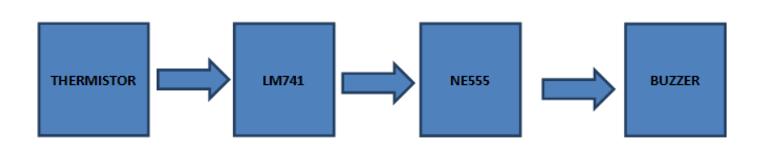
Block Diagram

Slide 6
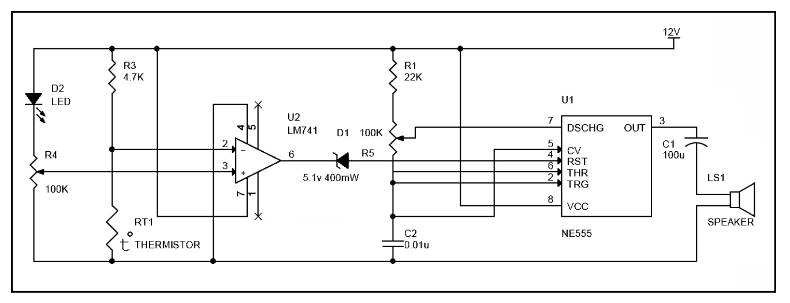
Circuit Diagram

Slide 7
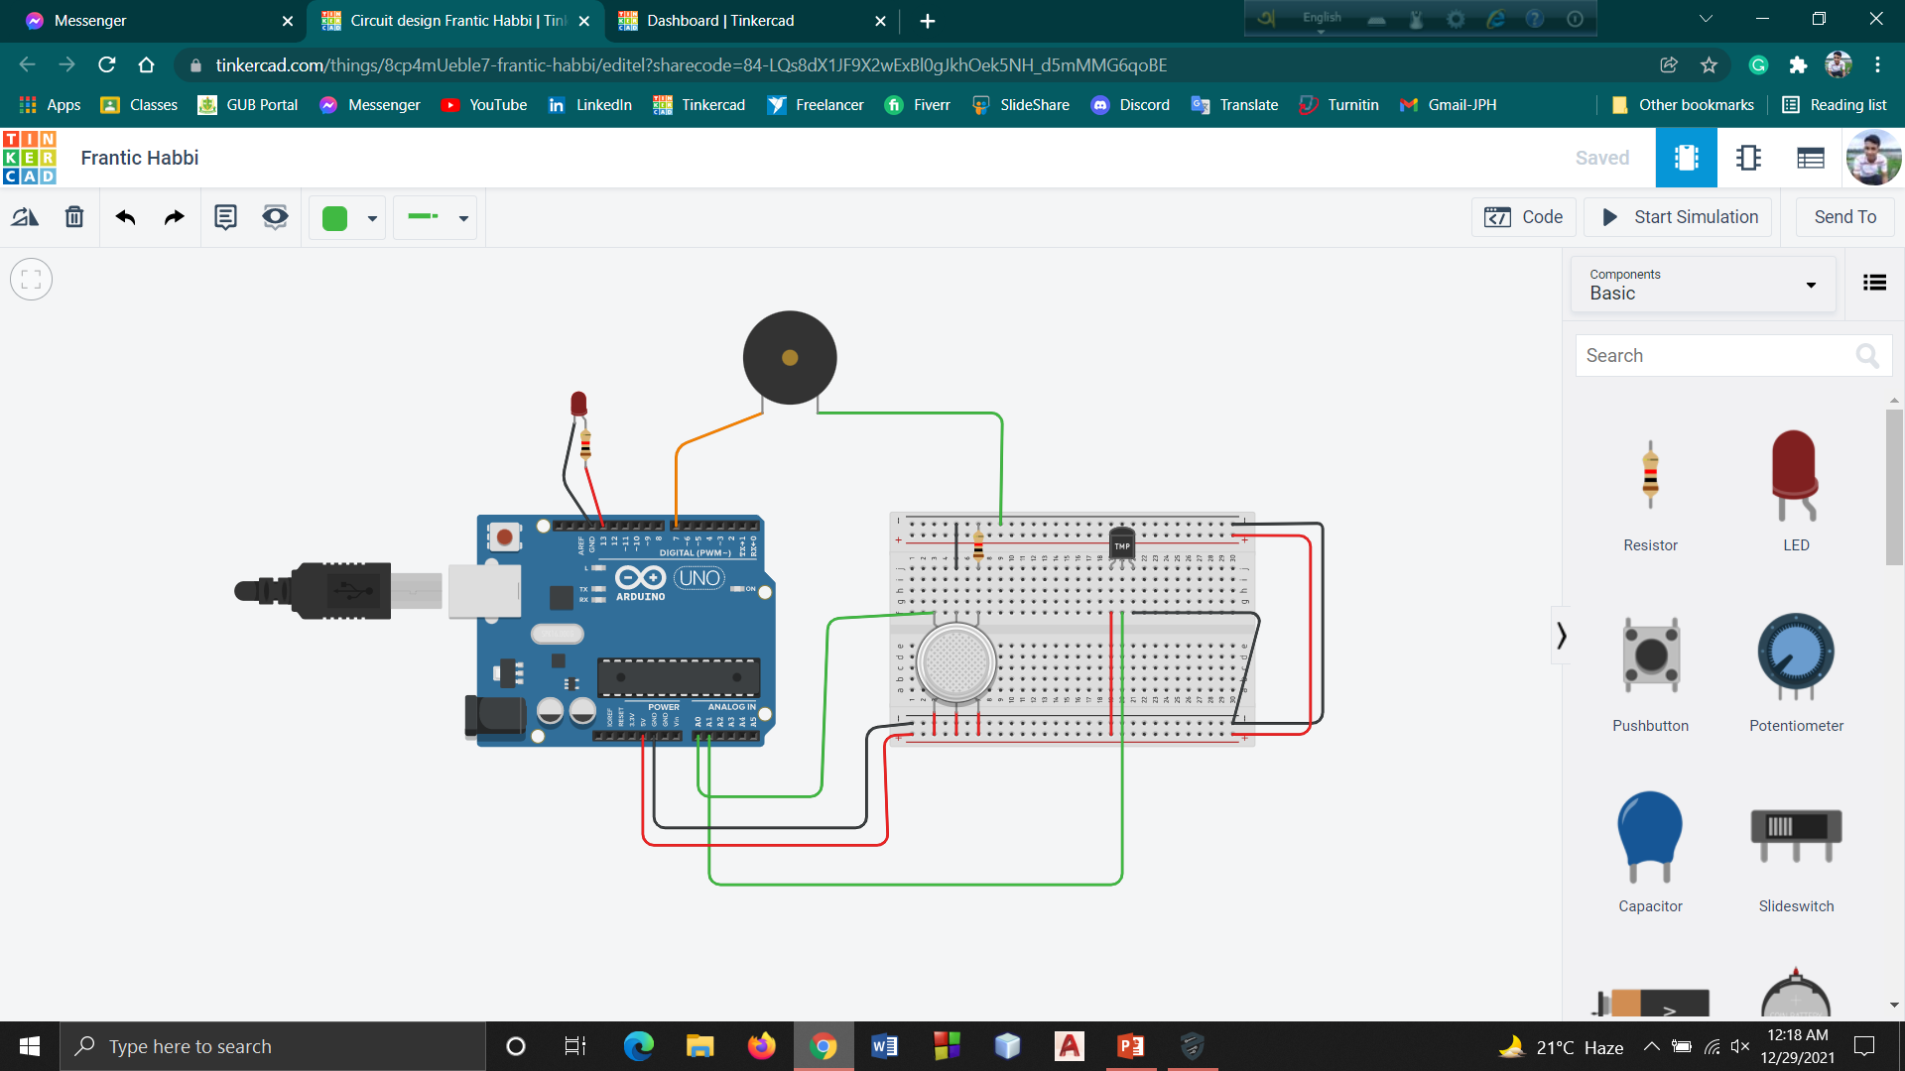
Implement on Tinkercad

Slide 8

Fire Alarm Device

Slide 9
Advantages
Early Detection
Every moment monitoring
Easy & Affordable
Disadvantages
Very high temparetures are not acceptable
May be slow to respond slow smoldering fires.

Slide 10
Uses
Institutional Buildings
Residential Apartments
Industries
Offices
Hospitals
Mall

Slide 11
Conclusion
The importance of these is it gives sound from fire alarm when fire attacks to industries, warehouses, etc.

Slide 12


